Slide 2
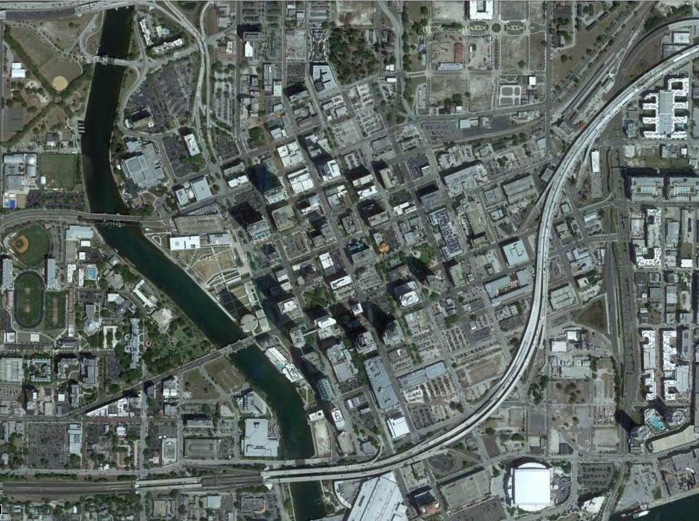

Slide 3
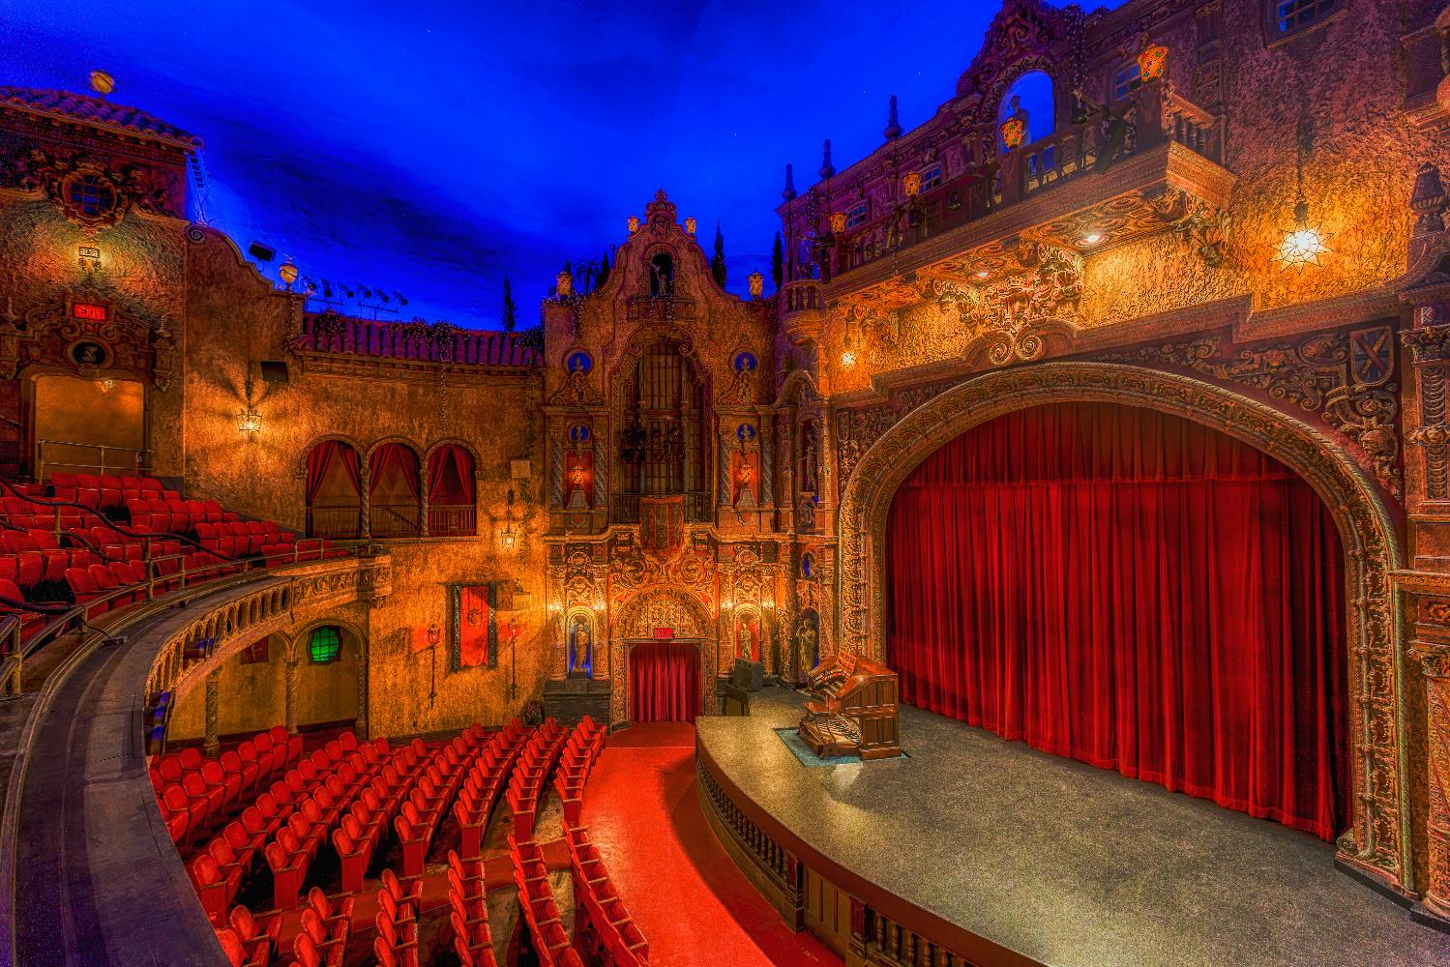

Slide 4
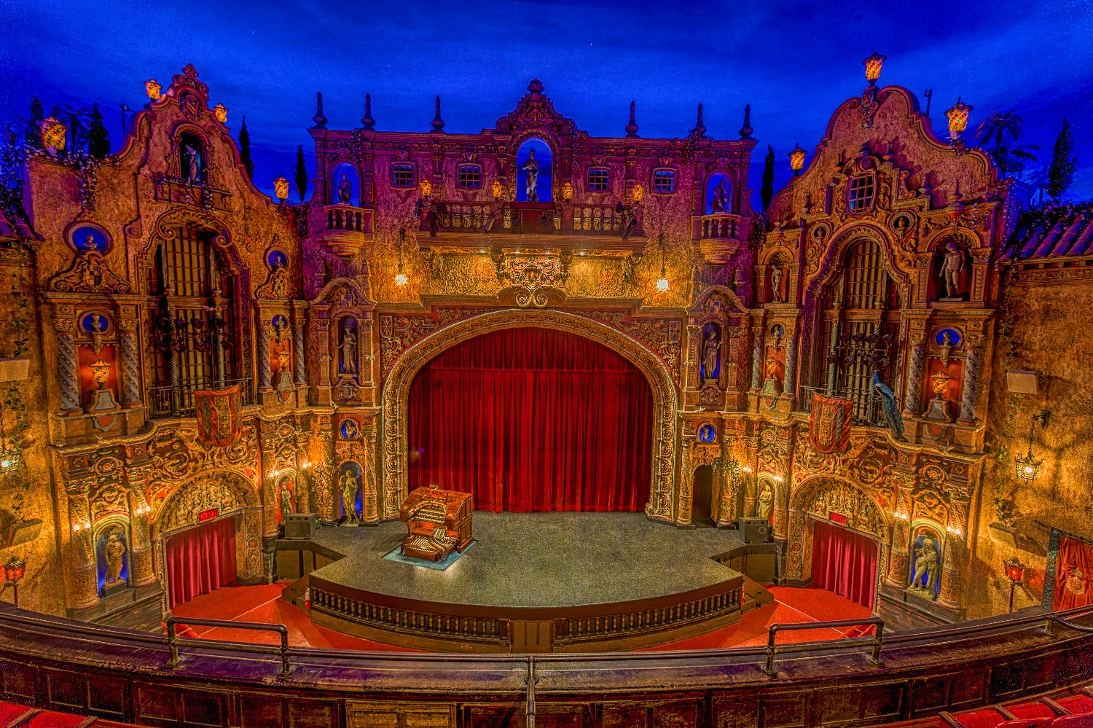

Slide 5
Seal the envelope
PHASE I
RESTORATION PRIORITES
MODERNIZe BUILDING SYSTEMS
START restoring the beauty
ImprovE patron comfort

Slide 6
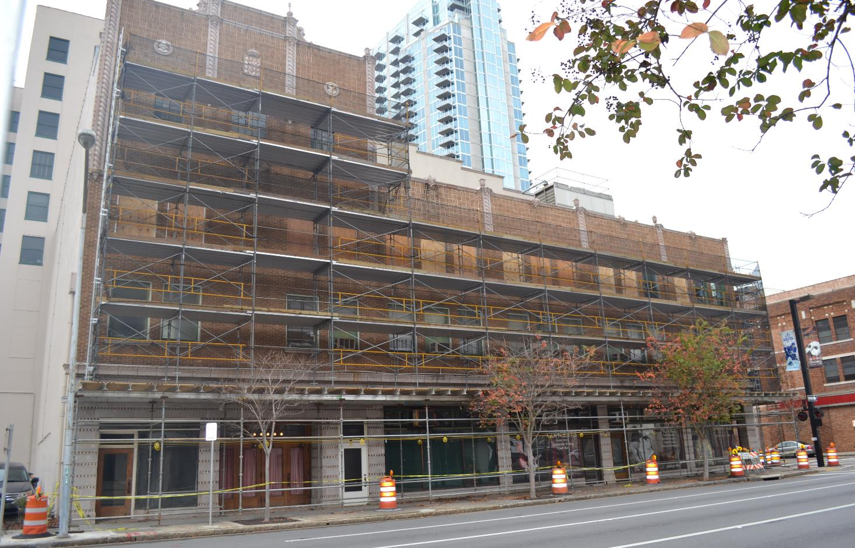
Sealing the envelope

Slide 7
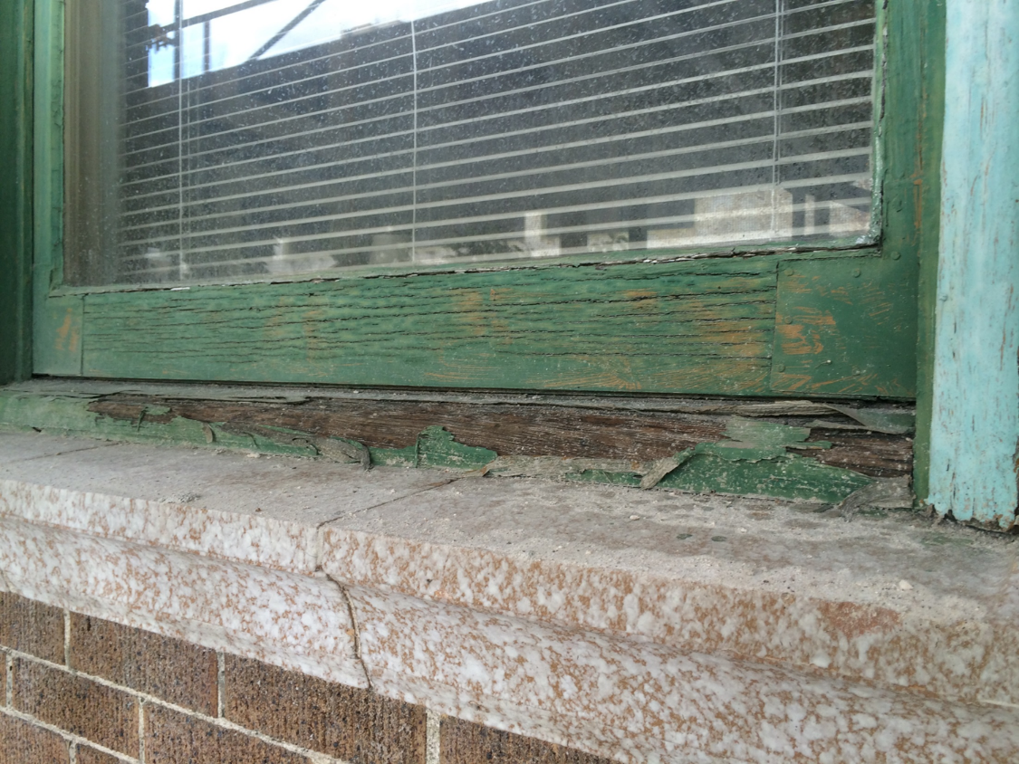

Slide 8
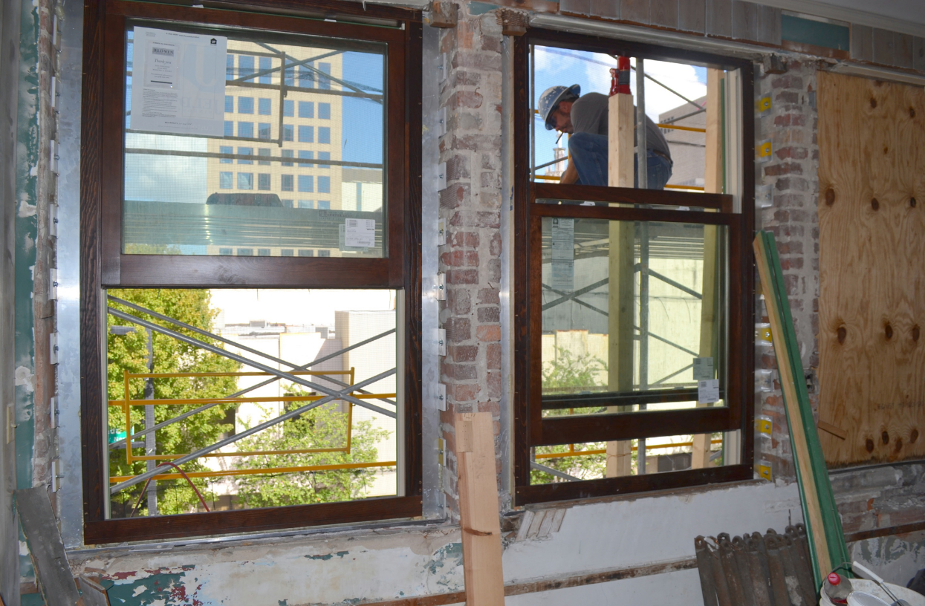

Slide 9
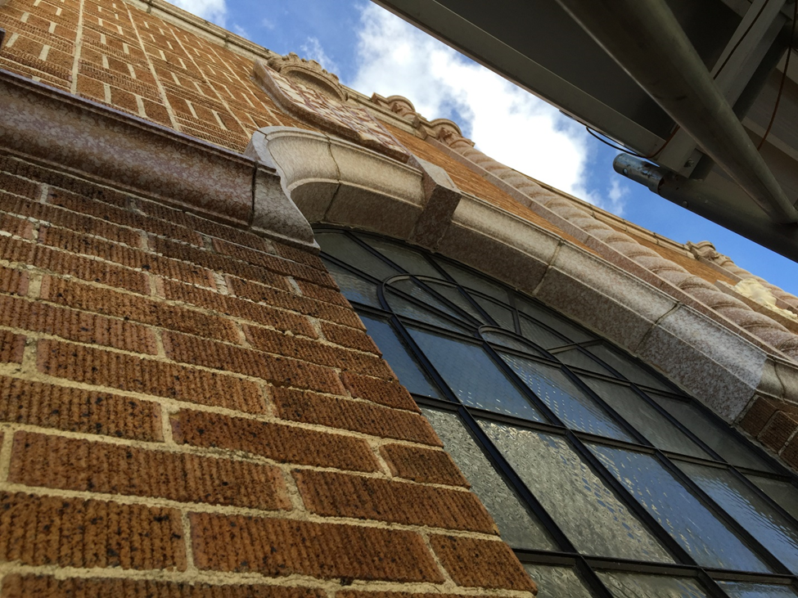

Slide 10
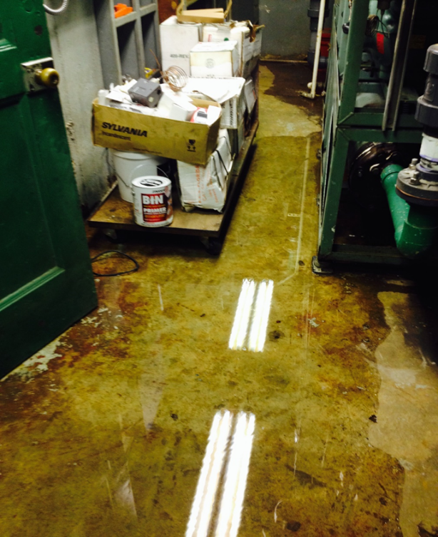
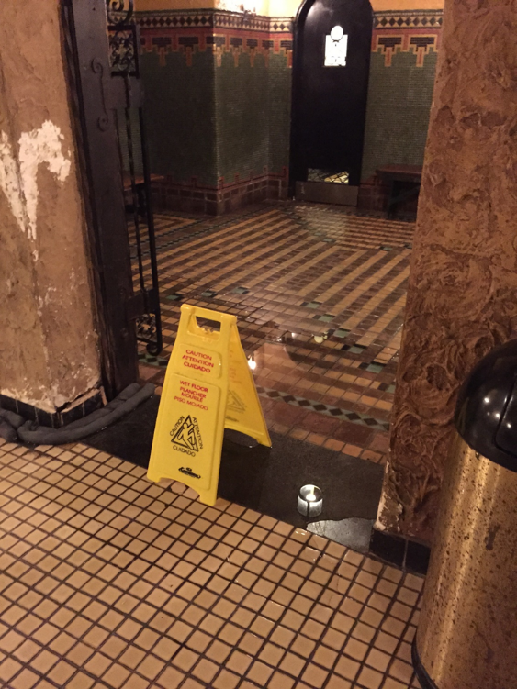

Slide 11
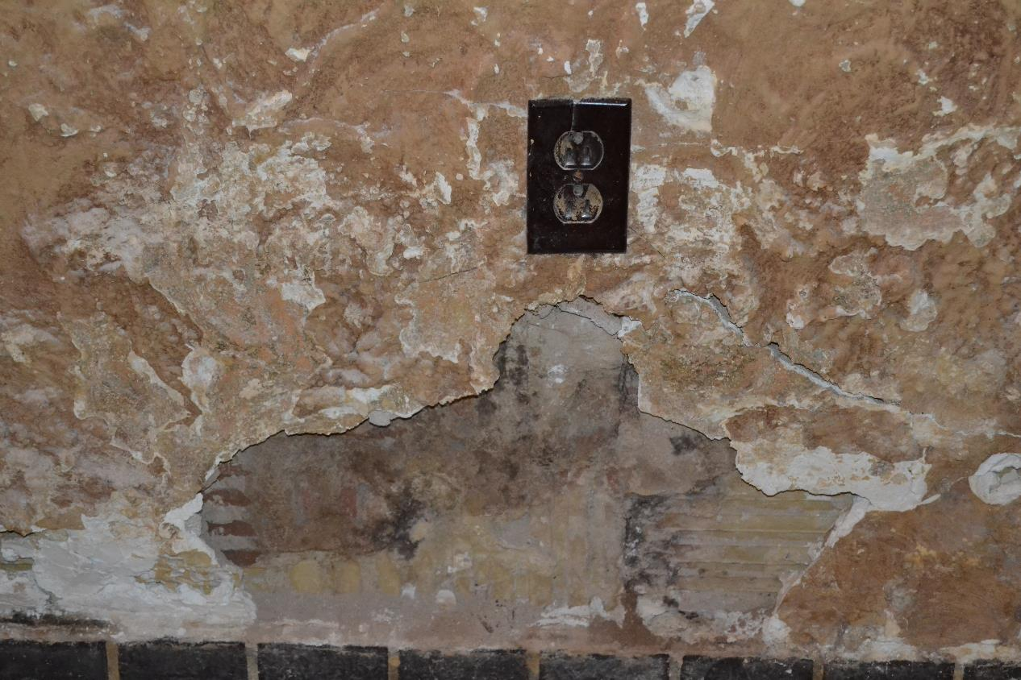

Slide 12
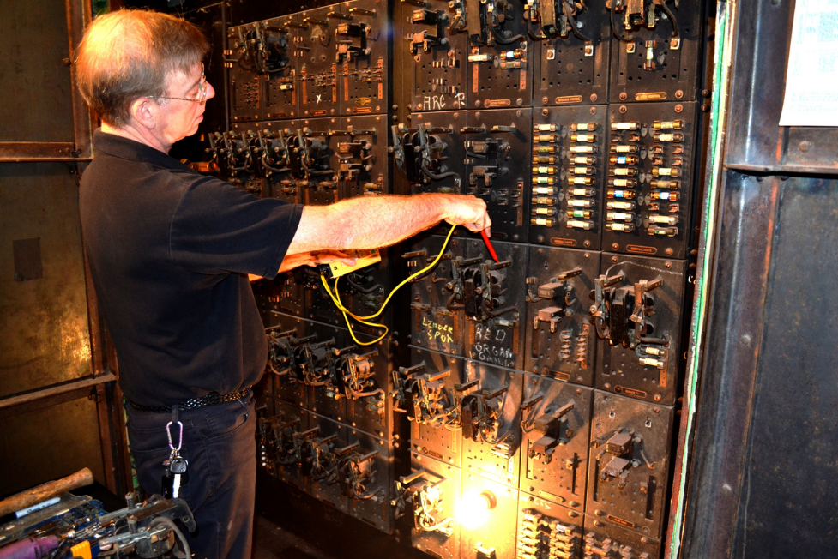
MODERNIZing BUILDING SYSTEMS

Slide 13
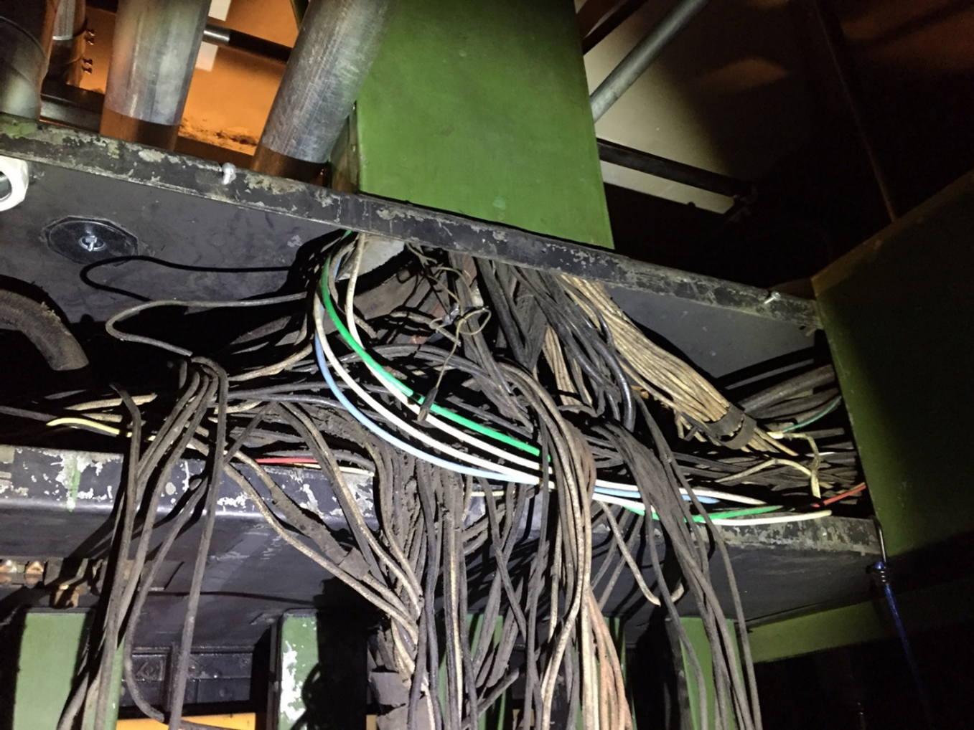

Slide 14
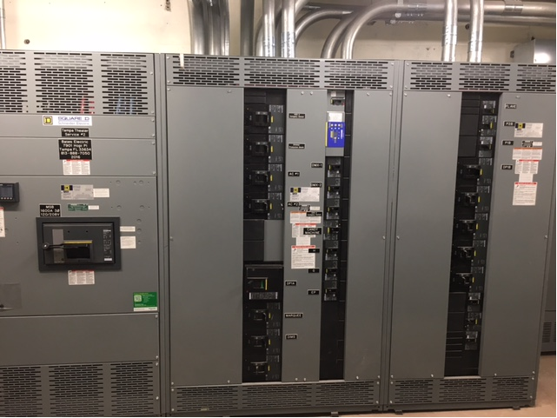

Slide 15
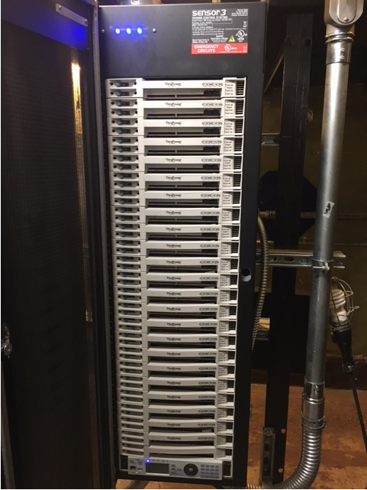
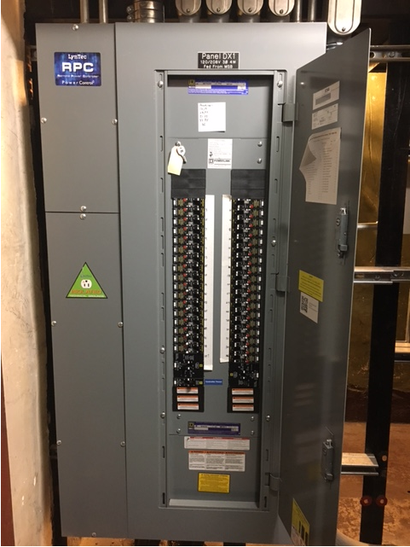

Slide 16
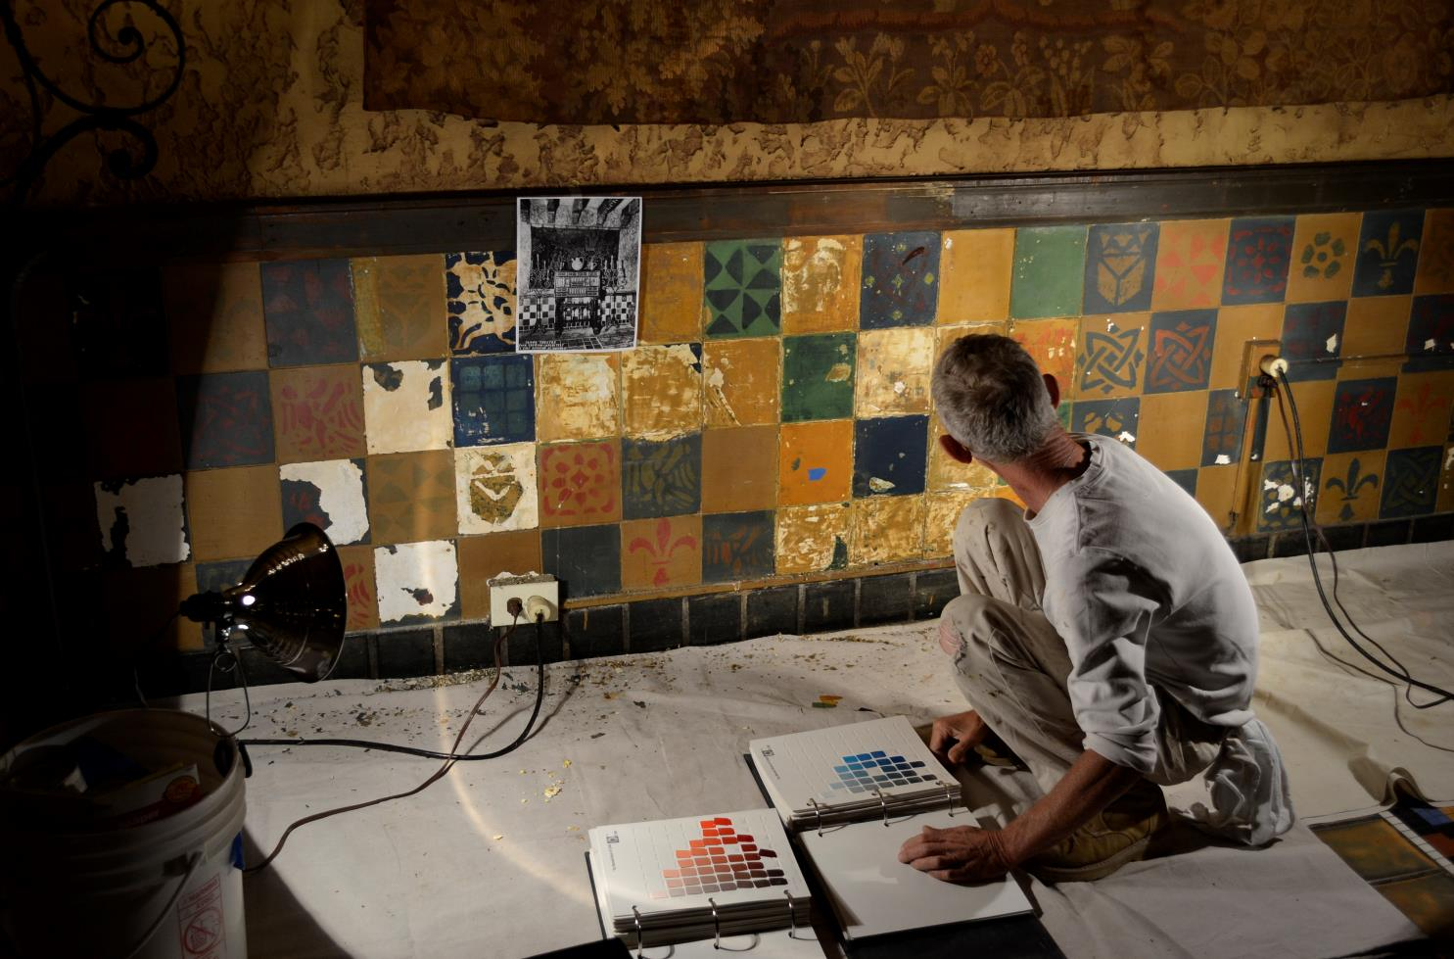
RESTORING THE BEAUTY

Slide 17
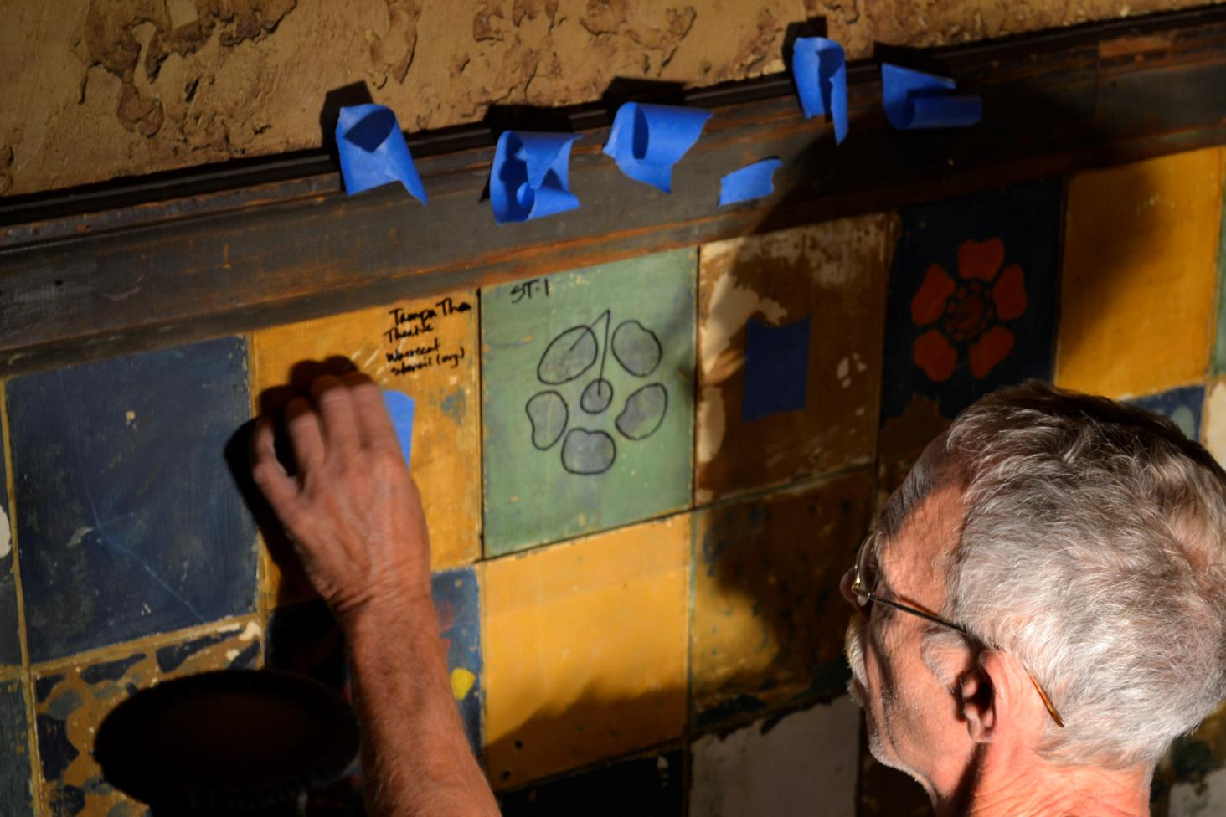

Slide 18
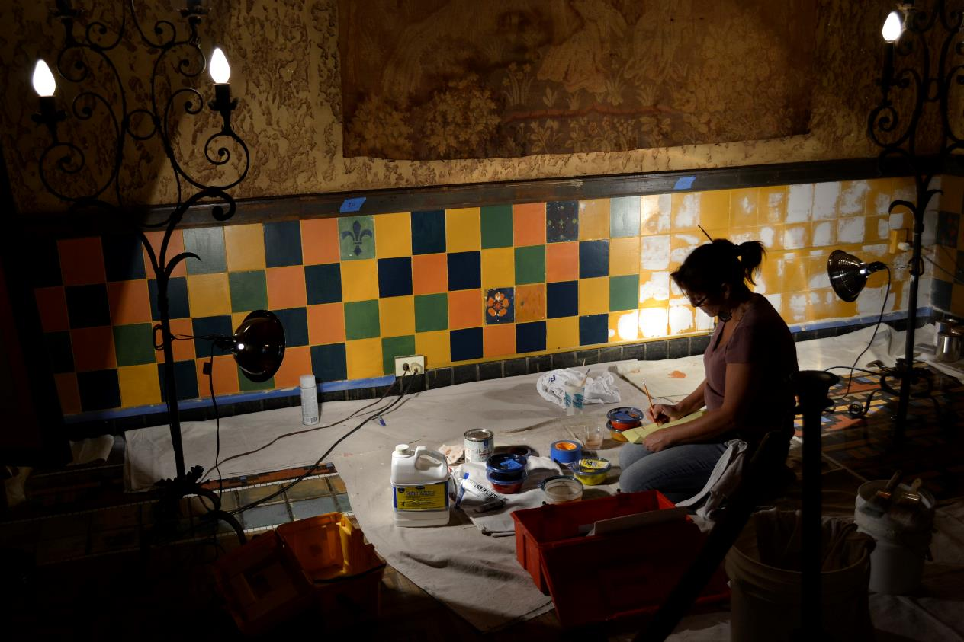

Slide 19
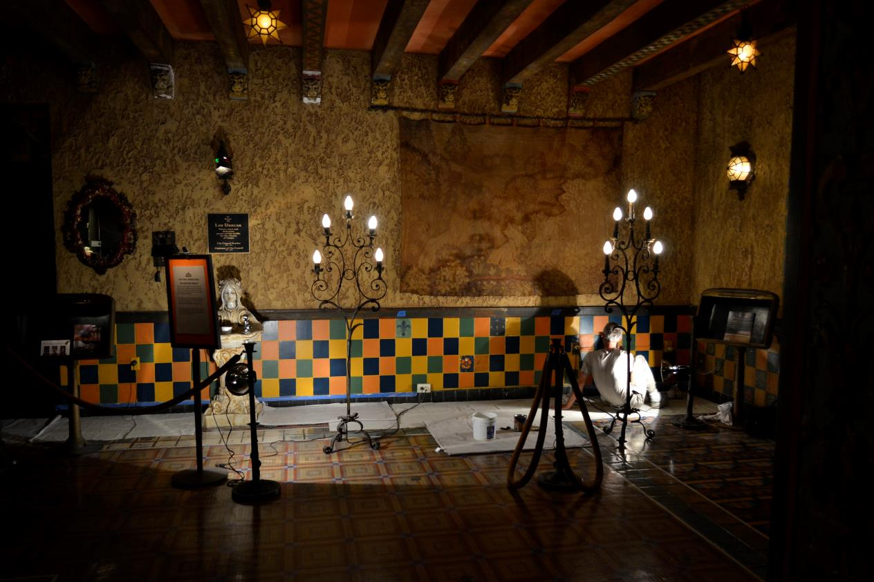

Slide 21
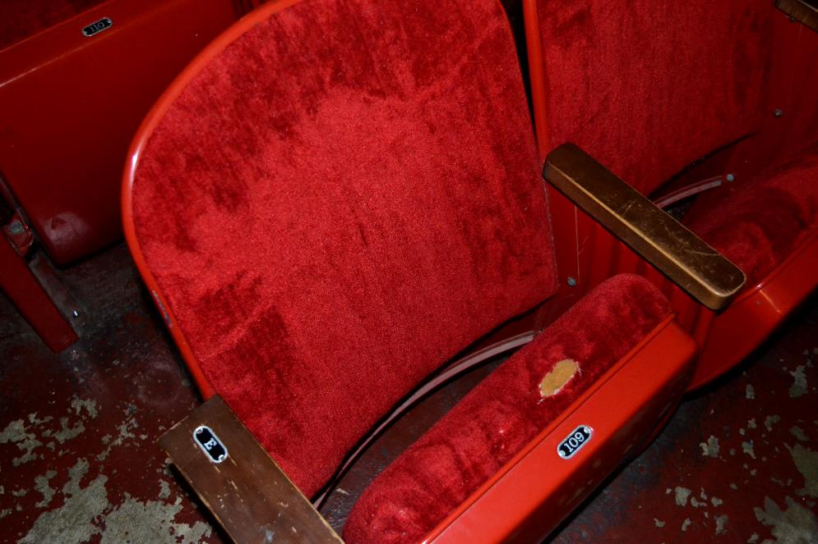
Improving patron comfort

Slide 22
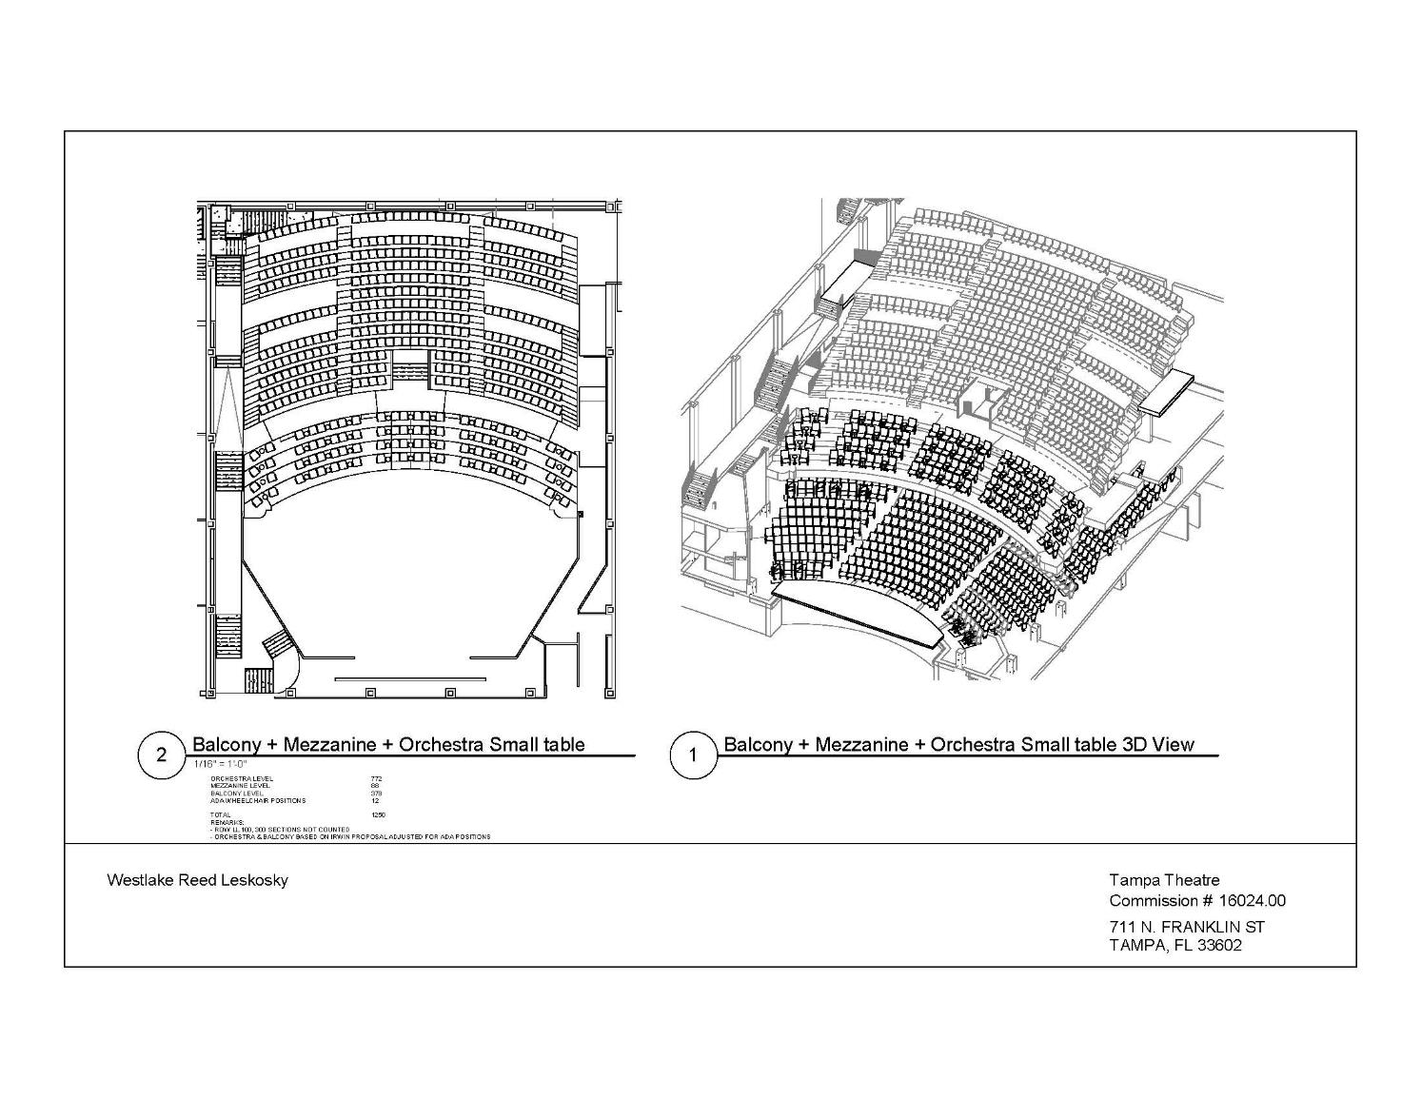

Slide 23
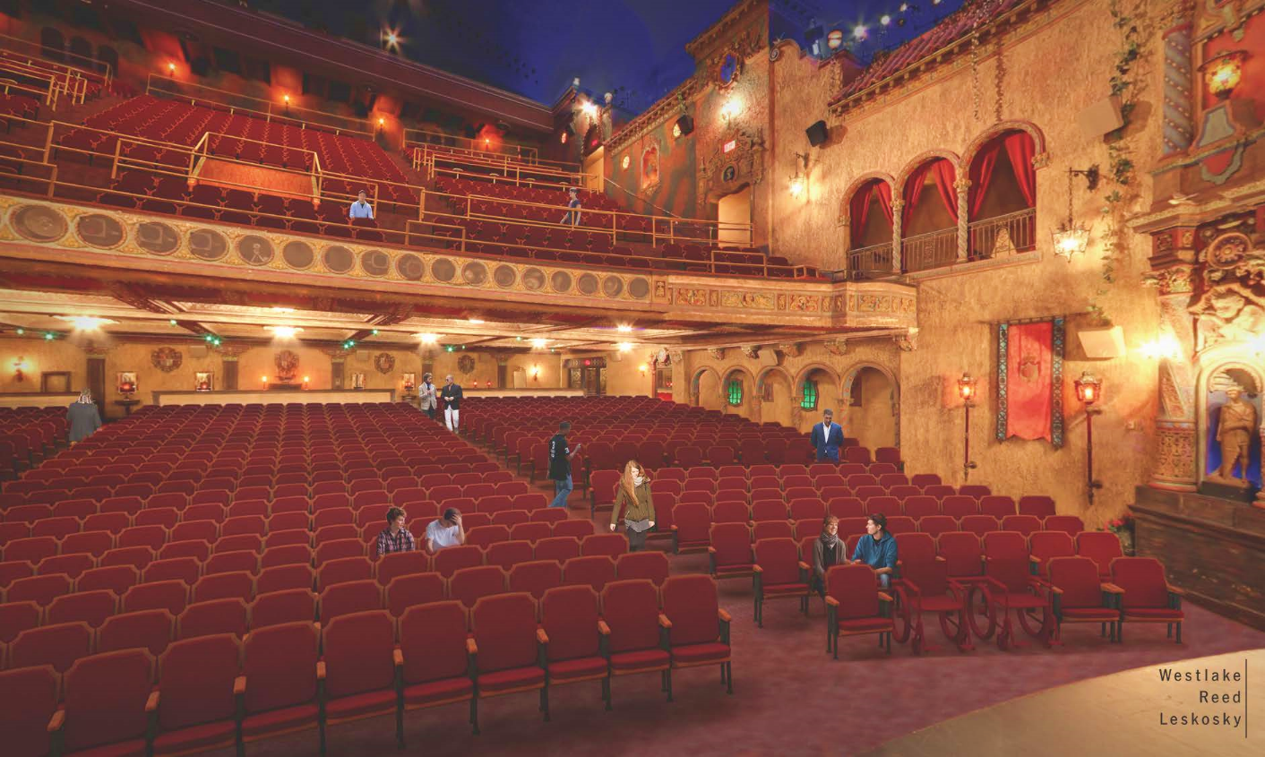

Slide 24
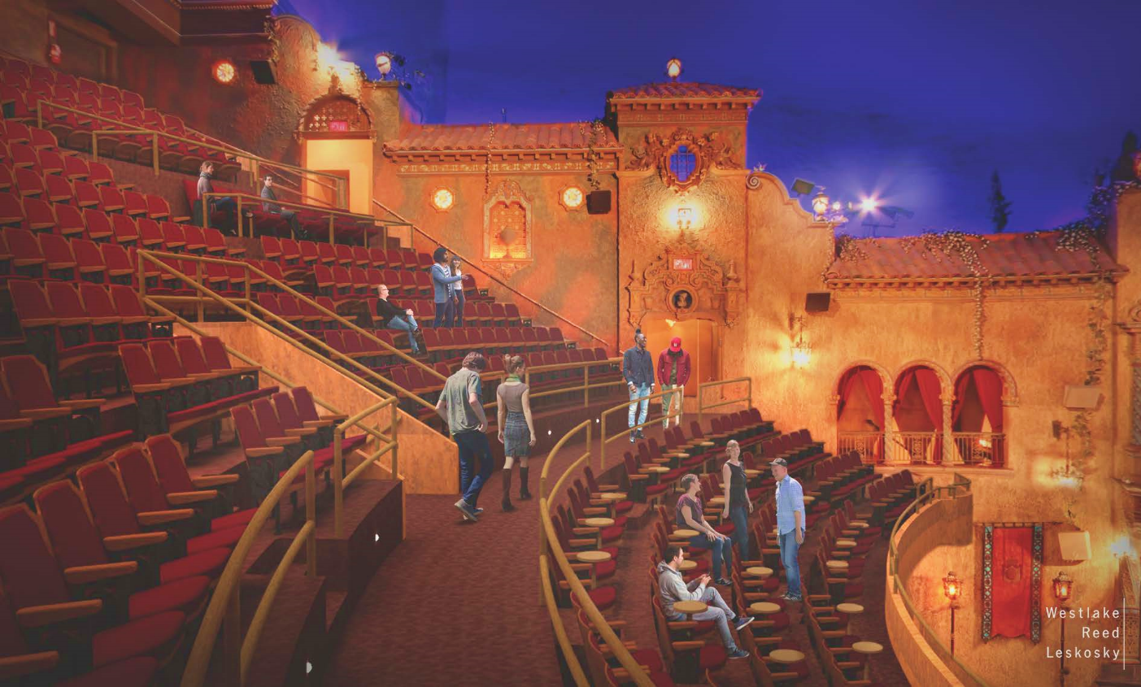

Slide 25
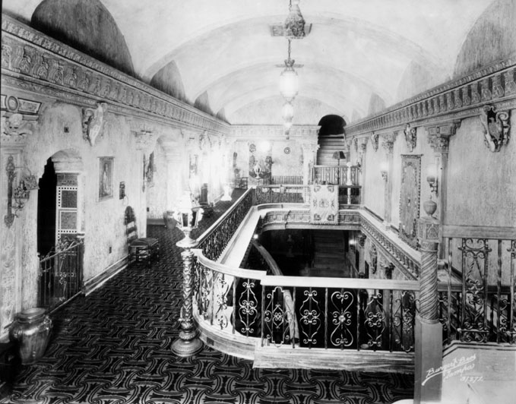

Slide 26
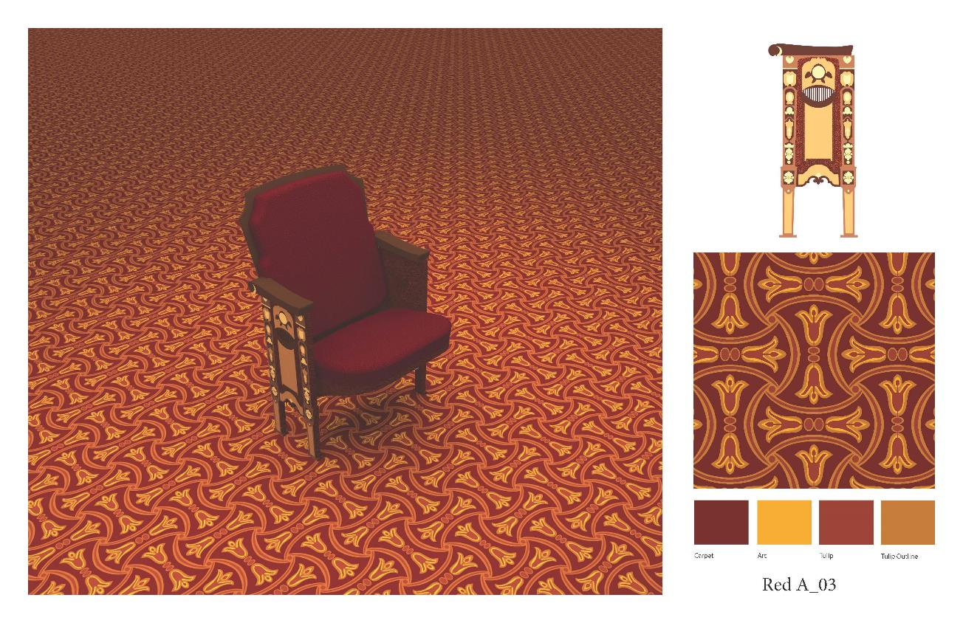

Slide 27
Tampa Theatre Restoration – Phase I Fundraising Status Report
Restoration Phase I Goal $6,000,000
Commitments to date $5,100,444
Remaining Need $899,556

Slide 28
CUSH YOUR TUSH
Seat Campaign
Text SEATS
to 243725
or visit TAMPATHEATRE.org/Cush-Your-Tush

Slide 29
Tampa Theatre Restoration
Future Fundraising Phases
Completion of Theatre Restoration $7,000,000
Building Preservation Endowment $10,000,000
Artistic & Educational Program Endowment $15,000,000
Total Future Capitalization Need $32,000,000

